Slide 1
Research Outcomes and Knowledge Mobilization
Virtual and Place-Based

Slide 2
Virtual Real-Time Conversations
Notes:
When first joined RRU in 2000 from UBC realized difficulties of working in a small university without an established research reputation
Strategy to be able to convene best minds in the country around critical public policy issues
Built a website, active blogging, tweeting and facebooking
Built e-Dialogue platform, recently redesigned and launched in September as Changing the Conversation
Two recent series—Revitalizing the Social Sector and The Climate Imperative

Slide 3
Research Projects
Social capital and agency
Canada Research Chair in Sustainable Community Development (2004-2014), www.crcresearch.org
Climate Change Adaptation and Mitigation, www.mc-3.ca
Places and Spaces
Sustainable Dialogues Canada
www.sustainablecanadadialogues.ca
Notes:
SDC is an example of unprecedented collaboration among scientists from the humanities, natural and social sciences, led by Catherine Potvin, from McGill University, extensive use of media to increase maximum impact and influence political agendas
Hyperlinks:
http://www.crcresearch.org/
http://www.mc-3.ca/
http://www.sustainablecanadadialogues.ca/en/

Slide 4
Peer-to-peer learning exchanges
Notes:
Focus on what we learned from our climate change work, over 15 partners from across the country and BC
Peer-to-peer learning exchanges
Virtual mayoral meetings
Link - https://www.youtube.com/watch?v=34YySBd_pGU

Slide 5
what is a living lab?
an experimental collaborative place & space for problem solving

Slide 6
purpose
to co-create innovative and sustainable solutions

Slide 7
how does it work?
Notes:
uses design thinking processes that are interdisciplinary, evidence-based, and user-centric to co-create innovative and sustainable solutions to complex problems
collaboration and partnerships critical - diverse perspectives and skill-sets lead to improved relationships, holistic rethinking of problems, and outcomes strengthened by inclusion
creative, safe, experimental space encourages out-of-the box thinking
systems-mapping of problems, focused on connections and causes, is more useful than traditional siloed analysis

Slide 8
who benefits?
what’s the value?

Slide 9
what makes it “living”?
offers creative safe space to fail and succeed
values process and outcome
seeks solutions that can be scaled and adapted to need, lead to sustainable outcomes and make better use of scarce resources
and…

Slide 10
what makes it “living”?
openly and strategically shares iterative knowledge …
to broaden and deepen knowledge mobilization and accelerate innovation

Slide 11
without sharing

Slide 12
with sharing

Slide 13
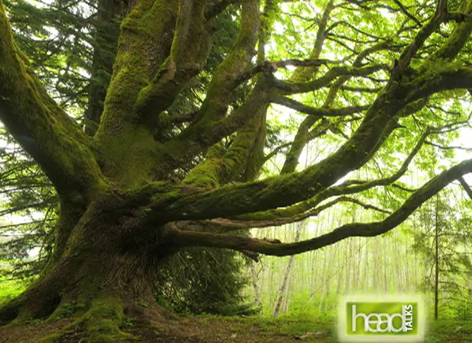
Social Media
Notes:
Now to talk about HEADTalks
first is the trailer: https://youtu.be/BV2Bighv27M
Second is the student food video, talk about partnership with the school (involving students in the research process, will briefly discuss how first two runs of the partnership were thematic and third was much more ‘open’): https://www.youtube.com/watch?v=5NC5lwx9-X8

Slide 14
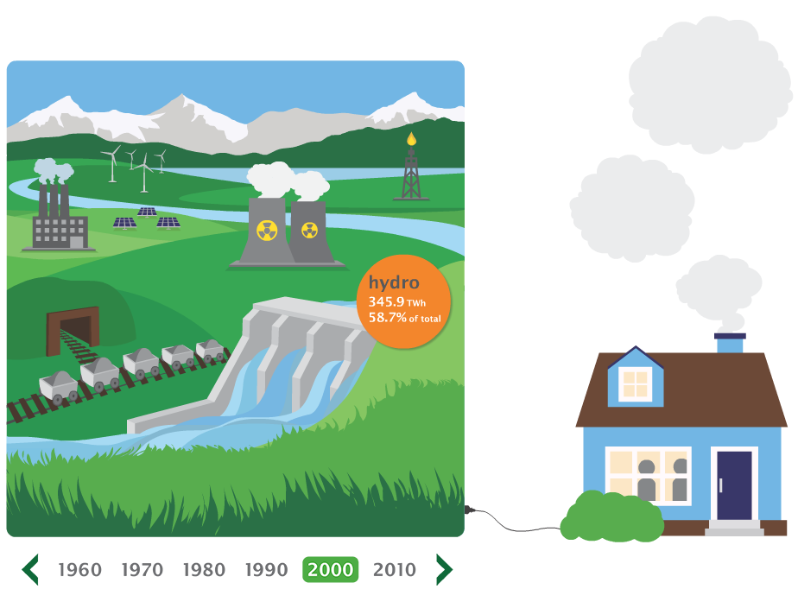
Research Curation
Optimizing the reach and impacts of research
Connecting the public with research projects
Making sense of data (i.e., visualization)
Notes:
The need for research curation
operating within the ‘noise’ of the Internet – connecting the dots and hyperlinking
connect the public with research outcomes and research process

Slide 15
Next Steps
Changing the Conversation
www.changingtheconversation.ca
CoLabS
Notes:
Hyperlink:
http://www.changingtheconversation.ca/

