Slide 1
100% Renewables by 2050:
The Future of the Grid
Implementation: How will we get there?
Prof. Deborah de Lange, PhD
Ted Rogers School of Management
Center for Urban Energy
Ryerson University

Slide 2
Agenda
Why “100% Renewables” is a GOAL as well as a SOLUTION
How we may transition to 100% Renewables – A study is underway

Slide 3
The Goal is Clear, The Plan is NOT
Climate change mitigation... natural disasters... business resilience... energy security given the challenges of globalization and political instability...population growth and mega cities...
... as well as affordable, almost costless, energy independence that offers a higher standard of living for all.
100% Renewables is a SOLUTION and a GOAL.
Note: 100% Renewables is achievable everywhere as we have the technology - this is well understood in Europe where they are running optimization simulations (Bussar et al., 2014).

Slide 4
Why 100% Renewables is a GOAL
We not only REQUIRE a shift to 100% renewables, but we also DESIRE it.
Cleaner, healthier and lower risk living and working environments
Avoid fluctuations in energy prices
Avoid foreign control over our energy supplies and the wars that have accompanied fossil fuels
After infrastructure is installed, much cheaper, almost free energy
More reliable and resilient energy systems re: storms and blackouts
Greater worldwide equity in access to energy

Slide 5
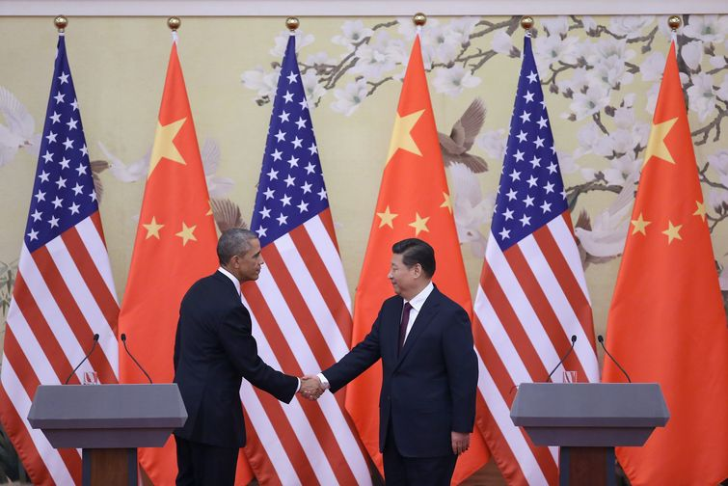
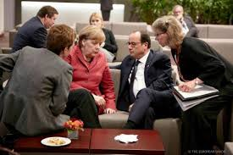
Recent News – What about Canada?
How are we going to catch up?
How America and China Broke
the Global Climate Trap
European Leaders Agree on Targets to Fight Climate Change
Even academic papers do not mention Canada when it comes to progress or targets on renewables. Countries mentioned include: EU, Germany, US, Japan, China, Egypt, Phillipines, and Brazil ( Mohsen et al. 2014). Emerging economies are doing more than us.
Notes:
"The United States intends to achieve an economy-wide target of reducing its emissions by 26 percent - 28 percent below its 2005 level in 2025 and to make best efforts to reduce its emissions by 28 percent.
"China intends to achieve the peaking of CO2 emissions around 2030 and to make best efforts to peak early and intends to increase the share of non-fossil fuels in primary energy consumption to around 20 percent by 2030.“ http://www.npr.org/blogs/thetwo-way/2014/11/12/363467360/china-and-u-s-titans-of-carbon-pollution-move-to-cut-gases
The climate and energy package is a set of binding legislation which aims to ensure the European Union meets its ambitious climate and energy targets for 2020.
http://ec.europa.eu/clima/policies/package/index_en.htm
These targets, known as the "20-20-20" targets, set three key objectives for 2020:
A 20% reduction in EU greenhouse gas emissions from 1990 levels;
Raising the share of EU energy consumption produced from renewable resources to 20%;
A 20% improvement in the EU's energy efficiency.
EU leaders agree to landmark 2030 climate deal
http://www.france24.com/en/20141024-european-union-2030-climate-deal-greenhouse-gases/
An overall 2030 target was agreed for the 28-nation bloc to cut its carbon emissions by at least 40 percent from levels seen in the benchmark year of 1990. An existing goal of a 20 percent cut by 2020 has already been nearly met.

Slide 6






Winners Embrace Change and Become MORE Competitive
How are WE going to be characterized by HISTORY?
The world is changing and it is OUR CHOICE as to whether we are going to be a competitive player or not.

Slide 7
100% Renewables:
Thoughts on an Implementation Plan
A Sketch of a Vision for Canada

Slide 8
Key Attributes of an Improved Power System
Global, regional, national, provincial, municipal, community systems
A global system is preferred:
Mitigate climate change
Service billions in growing mega cities and remote spaces
Increase standard of living globally
Energy security
  Technological wars & terrorism
  Natural disasters
  System instability
Notes:
Accessible power and knowledge through the internet – cannot have separation re: cost of electricity for accessing the internet and learning at home (re: no light at night)

Slide 9
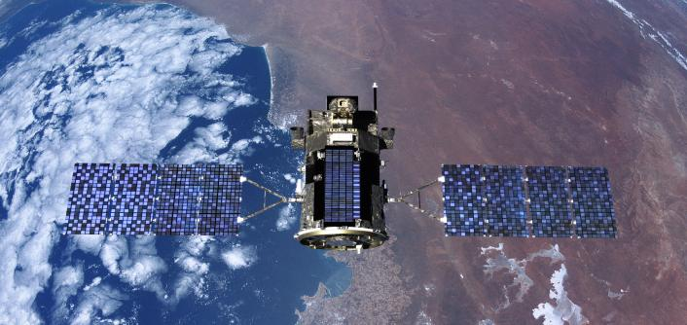
The Optimal Solution
Satellite Solar Power (SSP)
BIG Problem
No intermittency of power and solar can replace all power for 10B people
Avoid surface power generation stations and related dangers & waste
Deployed by 2020 (Macauley & Shih, 2007)
Notes:
Wireless power or wireless energy transmission is the transmission of electrical energy from a power source to an electrical load without man-madeconductors. Wireless transmission is useful in cases where interconnecting wires are inconvenient, hazardous, or impossible. The problem of wirelesspower transmission differs from that of wireless telecommunications, such as radio. In the latter, the proportion of energy received becomes critical only if it is too low for the signal to be distinguished from the background noise. With wireless power, efficiency is a more significant parameter, enough energy sent out by the transmitter must arrive at the receiver or receivers to make the system economic.
The most common form of wireless power transmission is carried out using direct induction followed by resonant magnetic induction. Other methods under consideration are electromagnetic radiation in the form of microwaves or lasers^{[1]} and electrical conduction through natural media.^{[2]}
Wireless power is used in electric toothbrushes, RFID tags, medical implants and some vehicles, including maglev trains

Slide 10
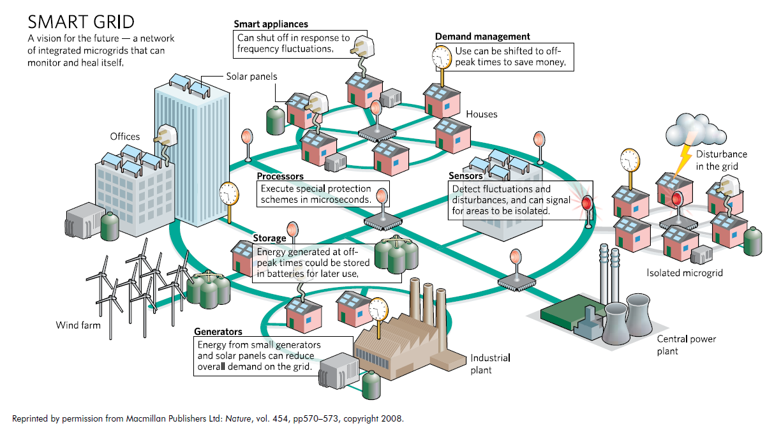
Compromise Solution: Distributed Generation
Energy Security
Notes:
See pp 25-26 of Reforming the Energy Vision (NYC plan)
The incumbent utilities already possess the particular and unique resources needed to
transform the grid and realize the REV vision. They can begin investigating and planning
immediately, and can most efficiently design and construct upgrades to existing distribution
systems. In many instances, the upgrades needed to facilitate two-way power flows, automated
controls, instantaneous communications and dynamic management of energy sources and loads
can and will be designed and engineered to work with existing facilities. The incumbent utilities
are best positioned to carry out this work. Their existing resources and capabilities, including an
experienced and specialized workforce, will be critical to an informed and efficient rebuilding of
the electric grid.
In taking on the role of DSPP, the distribution utility expands its function from being a
physical conduit for delivery of electricity, to also being a transactional platform for a
distribution-level market. The relationship between utilities and regulators has long been shaped
by the fact that physical delivery of electricity across a service territory has been a natural
monopoly. The introduction of widespread distributed resources can be perceived as challenging
the natural monopoly model of utilities. But even if the sources of power are distributed, the
need for a single entity to be responsible for reliability of the overall system remains. The REV
vision does not eliminate the natural monopoly of the distribution system operator; rather the
locus of the natural monopoly is shifted from sheer physical delivery to management of a
complex system of inputs and outputs while maintaining reliability.
Pp28-30
Although microgrids are only one form of DER, they warrant separate discussion here because there are several regulatory issues unique to microgrids that must be addressed. Tariffs for utility backup service need to be analyzed for their application in a multi-customer or campus setting; standards for interconnection need a similar analysis. Also, regulatory uncertainties are created where one person within a microgrid sells power to another, where existing utility lines within the microgrid are used, and where the lines of a microgrid cross public rights-of-way.
If interconnecting at the distribution level, an interconnection agreement must be made between the microgrid facility and the local distribution utility. Distributed resources including microgrids must meet the technical requirements that allow for parallel operation with the utility system. During a utility grid outage, the microgrid can intentionally island itself to maintain critical loads. In such a configuration, equipment must be employed to ensure the safe and appropriate disconnection of the microgrid from the rest of the grid. It is critical that the islanding is intentional as it ensures that the surrounding grid will not be unintentionally energized (backfed) by the energy resources contained with the microgrid. Isolating from the grid to provide service in the event of widespread outages can be a considerable benefit for customers. In addition to ensuring safe operations, reliability and resiliency concerns must also be addressed. Infrastructure must be employed within the microgrid to ensure good power quality, such as generation and load management (balancing) systems, and black start capability, which ensures that the microgrid can come online in the event of a utility grid outage.

Slide 11
LDCs
First, there is no threat to LDCs in terms of their future existence.
  NO plan on this planet eliminates the requirement for a grid connected system.
  The main problem is that we don’t have a Canadian plan.
A higher likelihood is that more grid connections will be required especially given the preference for a terrestrial and distributed rather than a spaced-based system.
  Renewable energy can be stored and shared widely via a super grid.
Even with DG, LDCs will have functions, but their focus and activities will change.
    Maintenance of local micro-grids and community renewable generation, tracking local energy supply and demand, initiating energy trading, oversight of local systems’ stability and coordination with the larger grid
    More sophisticated and more varied functions incorporating clean energy systems offering more interesting and safer jobs.
DG is not a threat, it is an opportunity to become better.
Notes:
“Renewable energy resources can be used for power generation as stand alone or isolated system but their benefits are significantly enhanced when they are integrated into electric utility system. With greater use of smart grid enabling technologies, higher degrees and rates of penetration can be accommodated.” (Ellabban, 2014)
Local Distribution Companies

Slide 12
A Vision for a Future Transition
We need a Canada-wide clean energy plan that coordinates on a North America wide scale
Consider the plans and actions of other areas of the world
We can take away some principles for our Made-in-Canada Clean Energy Plan

Slide 13
Bill C-634
An Act to establish a Canadian Environmental Bill of Rights
(Right to live in a Healthy Environment)
An Opportunity
Private Member’s Bill
http://www.parl.gc.ca/LegisInfo/BillDetails.aspx?Language=E&Mode=1&billId=6729653
David Suzuki
http://www.davidsuzuki.org/blogs/science-matters/2014/11/the-movement-for-environmental-rights-is-building/
Would this lead to a Canadian Clean Energy Plan?

Slide 14
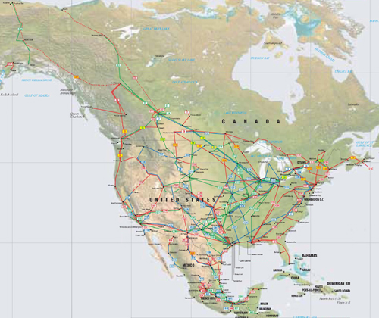
The Real Change: Grids Instead of Pipelines
Map of NA Pipelines
Rather than moving liquid fuels around, we will move electrical energy.
Electrical grids rather than pipelines.
Source: http://www.theodora.com/pipelines/north_america_oil_gas_and_products_pipelines.html

Slide 15
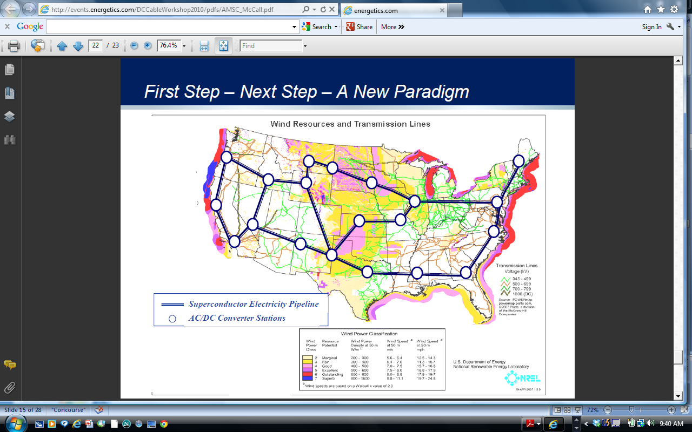
TresAmigas is
only the
beginning
Source: American Superconductor 2010

Slide 16
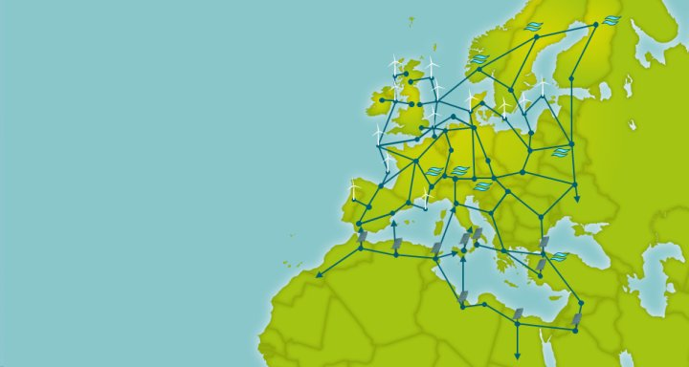
PAN EUROPEAN DC GRID
“a pan-European transmission network facilitating the integration of large-scale renewable energy and the balancing and transportation of electricity, with the aim of improving the
European market”.
“HVDC technology will open markets, strengthen security of supply and create another global opportunity for European companies to export sustainable energy technology. The technology underpinning the Supergrid will give competitive advantage to the companies involved with its specification and design. This type of integrated AC/DC grid will be a template for what will be needed in other global markets including the US and China.” - Friends of the Super Grid
Source: TresAmigas LLC Emerging HVDC Presentation 2013

Slide 17
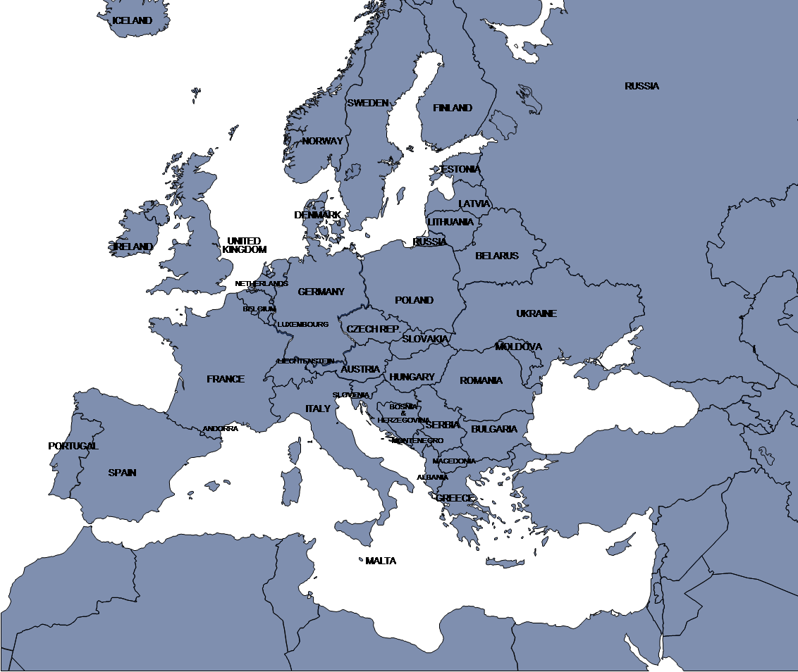
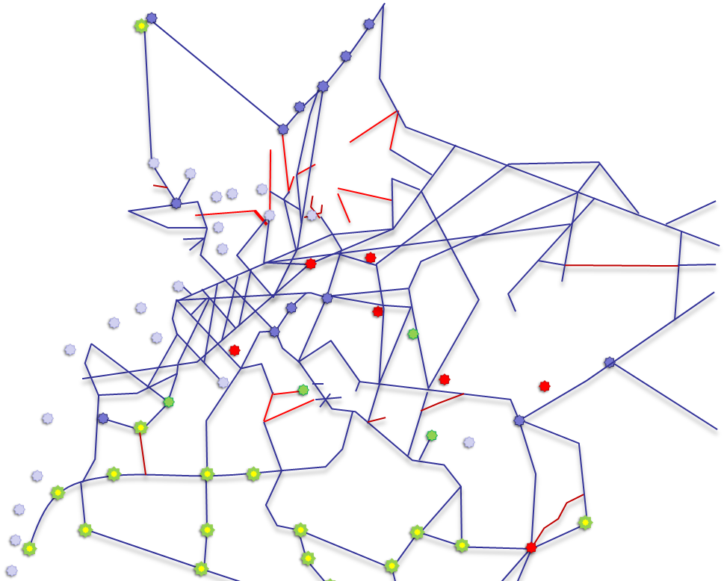
EUROPE: EXTENDED HVDC GRID PLAN
From Iceland (Northwest) to Israel (Southeast)
= 3,200 mi
Concept of grid is 25,000 miles of line
Solar Power
Wind Power
Geothermal
Hydro
Biomass
Connections already in place
or planned
Vision of ABB
and DLR
The new high-voltage network would range from the Sahara to the polar cap. The concept calls for main lines that are 40,000 kilometers long. And parts of it already exist.
Source: TresAmigas LLC Emerging Presentation 2012

Slide 18
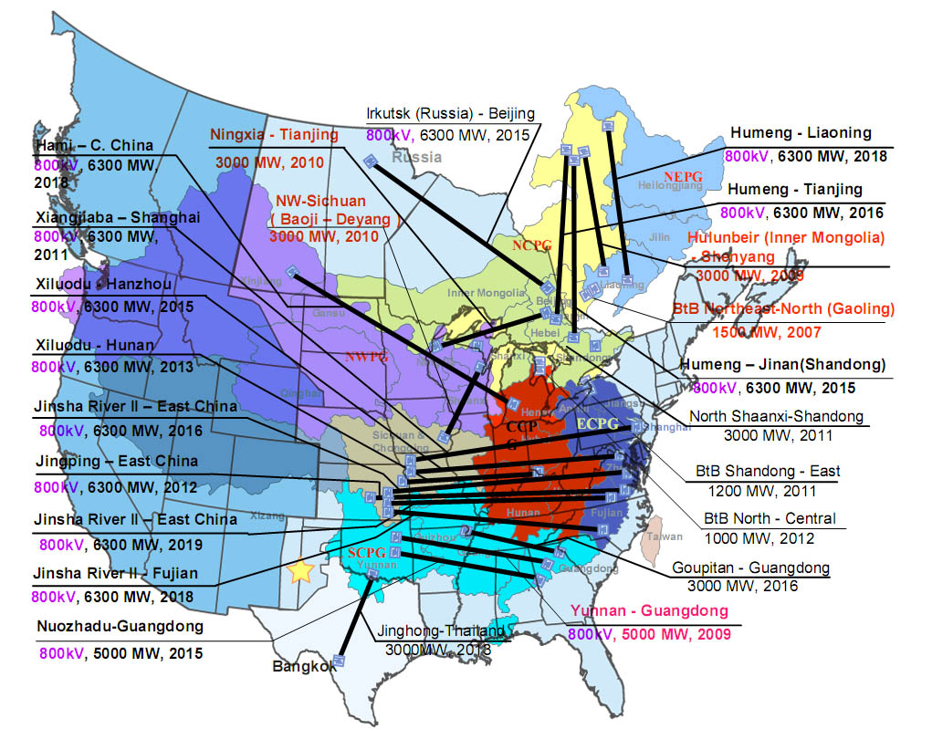
CHINA: POINT TO POINT HVDC
Source: TresAmigas LLC Emerging HVDC Presentation 2013

Slide 19

Canada’s Next Steps
Map and evaluate our renewable energy
resources regularly and accurately – install
power analytics technology (Big Data)
Notice that peripheral areas of Canada can benefit (re: Creutzig et al., 2014 and benefits to European periphery)
Plan a cross-Canada grid connected system with renewables, storage, micro- and super- grids (A Canadian Clean Energy Plan)
Measure our Canadian success using UNSEEA and an environmentally adjusted net domestic product (EDP rather than GDP).
Coordinate with the US and Mexico for future energy trading and resilience

Slide 20
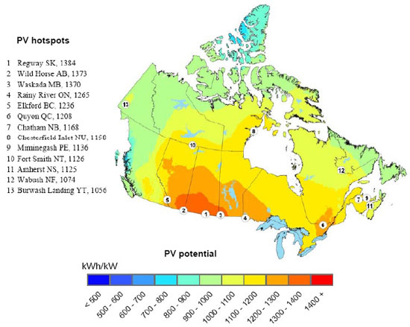
Solar Energy in Canada
Source: Global Energy Network Institute
Notes:
Source: http://www.geni.org/globalenergy/library/renewable-energy-resources/world/north-america/solar-north-america/solar-canada.shtml

Slide 21
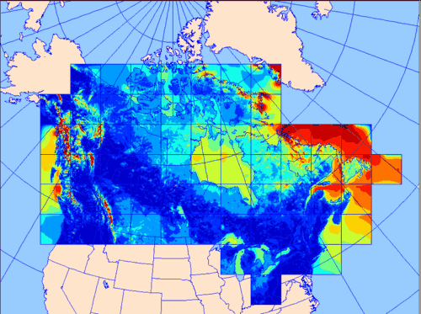
Wind Energy in Canada
Source: Canadian Wind Energy Atlas
Notes:
Source: http://www.windatlas.ca/en/maps.php?field=E1&height=50&season=ANU

Slide 22
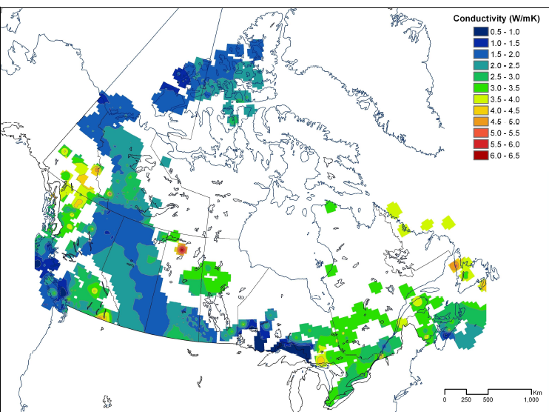
Geothermal Energy in Canada
Canada has enough
geothermal energy
to supply the country’s total energy requirements.
Geothermal is broadly distributed but we only have 40% of the data.
Remote northern communities could benefit first.
Pattern of mean thermal conductivity (W/m K)
Source: Geological Survey of Canada 2012
Notes:
GSC releases Canadian Geothermal Potential Report
The Geological Survey of Canada and a team of leading scientists in the field of geothermal energy have released a report detailing the “Geothermal Energy Resource Potential in Canada”.
Some of their findings include:
Canada has enormous geothermal energy resources that could supply the country with a renewable and clean source of power.
Canada’s in-place geothermal power exceeds one million times Canada’s current electrical consumption.
The high capacity factor of geothermal power makes it particularly attractive as a renewable resource.
Remote northern communities could be the first to benefit from geothermal development in Canada.
The 322 page document can be accessed and downloaded from the GSC website
Special thanks to the authors: Grasby, S E; Allen, D M; Chen, Z; Ferguson, G; Jessop, A; Kelman, M; Ko, M; Majorowicz, J; Moore, M; Raymond, J; Therrien, R. Geological Survey of Canada,

Slide 23
Clean Future Commitments
Country | Current GHG Reduction | GHG Emissions Target | Renewable Energy Target
Canada Kyoto Withdrawl; Copenhagen Accord | GHG emissions are 17% higher than 1990 in 2009 | -6% below 1990 levels in 2012 Kyoto target 17% below 2005 levels by 2020 | No national target
Europe (EU) (10% of world emissions) Kyoto Germany; Sweden | 19.2% below 1990 levels in 2012 | -8% below 1990 levels in 2012 20% below 1990 levels in 2020 40% below 1990 by 2030 | 20% target by 2020 is expected to exceed (wind & hydro +) Total energy 27% by 2030; electricity 45% 45% by 2030; 51% now
California US (15% of world emissions) | On track New target agreement re: China | 1990 levels by 2020; 80% below 1990 levels by 2050 26-28% below 2005 levels by 2025 | 33% by 2020; 50% by 2030 20% by 2020
Australia Kyoto | On track in 2012 at 106% of 1990 levels | +8% of 1990 levels by 2012 | 20% by 2020 (41k GWh) Now reduced 26k GWh
Japan Kyoto | Japan Fukushima disaster set back | -6% of 1990 levels by 2012 | Japan 13.5% by 2020, 20% in 2030
New Zealand Kyoto | Increased by 25% of 1990 levels by 2012 | 1990 levels by 2012 | 90% by 2025
China (25% of world emissions) | New target re: US | Stop increase in GHG by 2030 | 2 times today ~ 800 GW by 2030
India (6% of world emissions) | Increasing | 20-25% below 2005 by 2020 (not binding) | 15% by 2020
Notes:
3 EU Countries Have Already Hit Their 2020 Renewable Energy Goals — You’ll Never Guess Them
http://cleantechnica.com/2014/03/13/3-eu-countries-already-hit-2020-renewable-energy-goals-youll-never-guess/
U.S.-China climate pact puts pressure on India
http://www.thestar.com/news/world/2014/11/14/uschina_climate_pact_puts_pressure_on_india.html
This week's deal raises expectations for India to step up its efforts, experts and environmental activists say.
ANUPAM NATH / AP
Smoke rises from burning garbage as an Indian woman looks for recyclable material at a dump near Gauhati, Indi on Friday. This week's China-U.S. climate agreement between the world's top two polluters puts pressure on India, No. 3 on the list.
By: Katy Daigle Associated Press, Published on Fri Nov 14 2014
NEW DELHI—This week’s China-U.S. climate agreement between the world’s top two polluters puts pressure on India, No. 3 on the list, to become more energy efficient and should encourage investment in renewable energy.
But the pact is also a relief for India because it acknowledges the long-held view among developing economies that industrialized nations have been emitting heat-trapping gases for many more decades and so should shoulder more of the burden for tackling climate change. Emerging economies argue they should have fewer constraints to pollute as they grow.
By showing the world’s two largest economies are working together toward a common goal with different efforts, the breakthrough agreement signals greater global co-operation over the contentious issue. That eases tension that could help future global climate talks while also raising expectations for India to step up its efforts, experts and environmental activists say.
“The international community will now expect India to make some firm commitments,” said Jairam Ramesh, the former head of India’s Environment Ministry.
And if China and the United States are going to work to develop cheaper forms of renewable energy, that will expand the industry in ways that would benefit India.
In the pact announced in Beijing earlier this week during President Barack Obama’s visit, China pledged to increase its renewable energy capacity to a 800 gigawatts by 2030, double today. By comparison, India only has about 30 gigawatts of renewable energy capacity today.
“That target, it’s huge. It’s a very positive signal to companies in the clean energy sector” to develop more efficient and affordable technologies, said former climate negotiator Prodipto Ghosh of The Energy Research Institute in New Delhi. “This will enable India to access these technologies in a few years, and to be honest I think this impetus will actually help the world reach its overall targets.”
Indian Prime Minister Narendra Modi has been a strong supporter of solar power, overseeing the addition of more than 600 megawatts in his home state of Gujarat. But his government has said little about negotiations for the new climate treaty intended to be finalized next year in Paris.
Scientists have warned that those talks may represent the world’s last chance to get emissions in check before the worst effects of climate change become unavoidable. But the U.S.-China agreement acknowledging that that developing and industrialized economies can make different efforts to tackling climate change should help negotiations go more smoothly, some experts said.
“The commitments from the two countries aren’t the same, and the U.S. has accepted that,” said Nitin Desai, a member of the Indian prime minister’s advisory council on climate change. “That makes things a lot easier moving forward.”
Last month, the European Union said it would cut its emissions 40 per cent by 2030, compared to 1990 levels. Taken together, the U.S, China and the EU account for more than half of global emissions, and there were already indications that other nations were feeling the pressure.
China emits a quarter of the world’s greenhouse gases, the United States 15 per cent and India about 6 per cent.
In its agreement with the U.S. — which isn’t legally binding — China pledged to halt the increase in its greenhouse gas emissions by 2030. The U.S. said it would aim to make its 2025 emissions between 26 and 28 per cent lower than they were in 2005, faster than previous goals.
The deal also focused renewed attention on per-capita emissions, or the country’s total greenhouse gases emissions divided by population — a measure that India has preferred. By this measure, India is one of the world’s least polluting countries at about 1.2 tons per person.
The United States said it would aim to bring down its per-capita emissions from about 20 tons while allowing China to raise its 8-9 tons per capita so that both reach a level of about 12 tons by 2030.
India has so far pledged to reduce its emissions intensity — that is how much carbon dioxide it puts out divided by its GDP — rather than promising to cut overall emissions. However, Indian officials and scientists say it could easily go beyond the target set in 2009 of cutting emissions intensity by 20-25 per cent below 2005 levels by 2020.
India’s preference for the per-capita emissions calculation, however, ignores the fact that around 400 million Indians still have no access to electricity at all, while hundreds of millions more are lucky to get a couple of hours a day. Experts worry that as India’s population continues to grow and more people become wealthy, its share of global emissions will skyrocket.

Slide 24
Canada, Back to being a Leader
To stand out in the crowd, we have to do something more and different.
Increasing our targets and cooperating internationally makes us one of the pack.
Revolutionary legislation that is based on the Right to a Healthy Environment could include:
    Clean energy policy (A Canadian Clean Energy Plan)
    Food policy
    Environmental science
    Forestry and national parks
    Indigenous rights and equity
...and other areas identified as related to building a “Healthy Environment” for all.

Slide 25
appendix

Slide 26
Stranded Assets?
Not in the grid...pipelines instead
Stranded assets in the grid are unlikely and power generation needs replacing anyway.
“By 2020, roughly 15% of Canada's electrical generation capacity will be more than 40 years old. 42,000 MW of new electrical generation capacity will be required to replace capacity as older plants are decommissioned and to meet new demand. The need to upgrade our generating capacity and meet new demand offers an opportunity to transition to renewable energy sources.” (Pembina Institute)

Slide 27
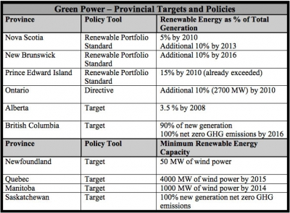
Canada’s Current State

